Slide 1
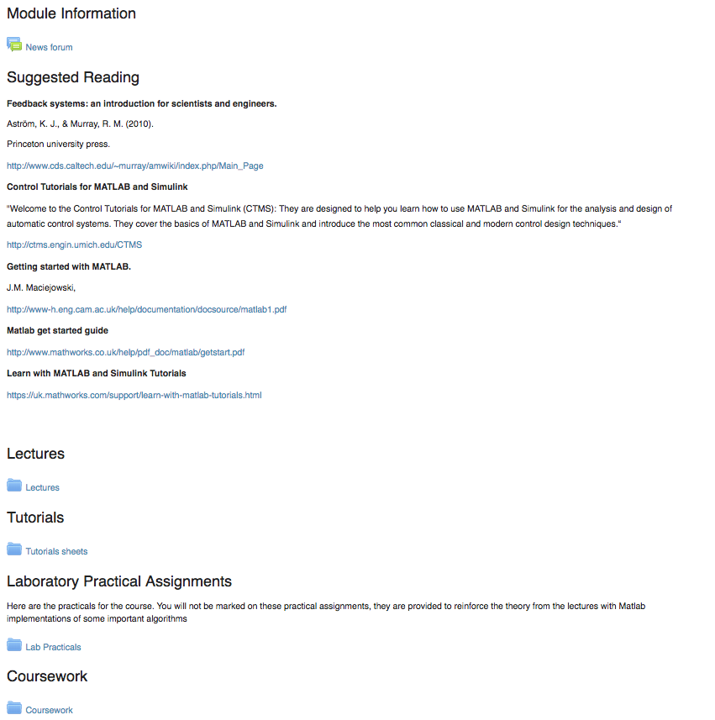
4 tutorials uploaded to DLE
Tutorials

Slide 2
Tutorials show working through typical exam questions I will go through tutorials in extra sessions Session tomorrow Room: BGB 005 Date: Tuesday, 20/03/2018 Time: 12:00-14:00 Today I will also go through tips and hints to help you do the coursework

Slide 3
Write down 3 things you like about the module Write down 3 things you think could be improved
Feedback time

Slide 4
ROCO218: Control Engineering Dr Ian Howard Lecture 7 Inverted pendulum velocity control

Slide 5
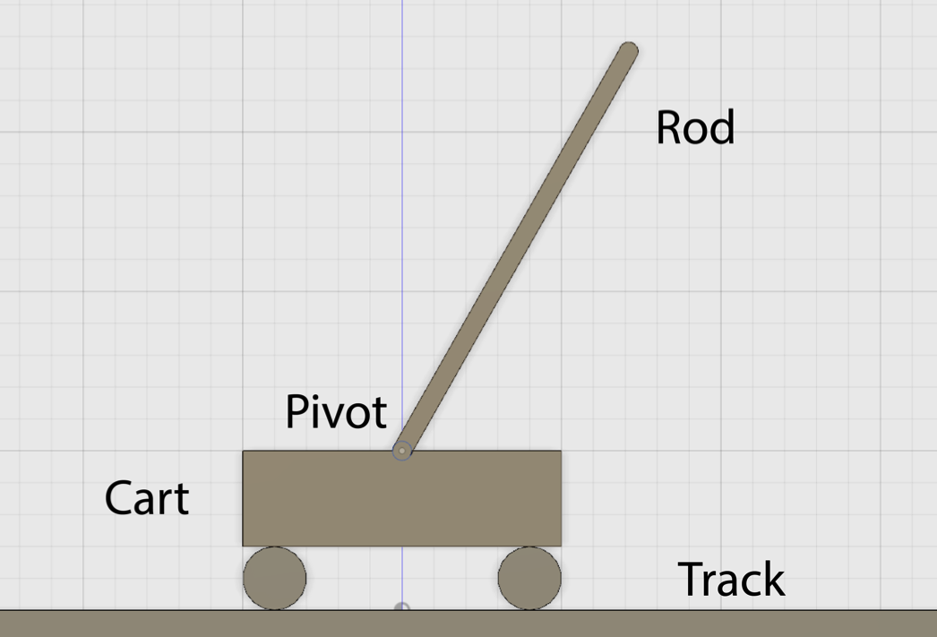
Inverted pendulum state space velocity control
The linearized differential equation describing the inverted pendulum is given by
Where:
The angle to the vertical is denoted by θ
The coefficient of viciously is denoted by μ
The mass of the pendulum is denoted by m
The moment of inertial of the rod about the center of mass is denoted by I
The length to the centre of mass is denoted by l
The displacement of the pivot is given by x_{p}

Slide 6
Velocity controlled inverted pendulum
Re-writing the differential equation describing the inverted pendulum
To control the pendulum by setting cart velocity we can write
This leads to the equation

Slide 7
Velocity controlled inverted pendulum
Given the equation
Let the constant terms be represented by the coefficients
Choosing state space representations

Slide 8
Velocity controlled inverted pendulum
From the state space representations
From before
Substituting into

Slide 9
Velocity controlled inverted pendulum
From the state space representations
State space notation takes the form
and
Writing in matrix format we therefore have

Slide 10
Velocity controlled inverted pendulum
From the state space representation
Where output y is the pendulum angle θ

Slide 11
Velocity controlled inverted pendulum
From
We can write the state space system matrices as

Slide 12
Augmenting positional state
In practice we may want to control cart position as well as angle and angular velocity!
Otherwise it might never stop moving!
We can add a third state x₃ to represent cart position
Since the control signal is cart velocity, the differential of x₃ is simply given by the input velocity control signal
Therefore we can write

Slide 13
Augmenting positional state
Substituting in value for the coefficients leads to the expression

Slide 14
ROCO218: Control Engineering Dr Ian Howard Lecture 7 Luenberger observer

Slide 15
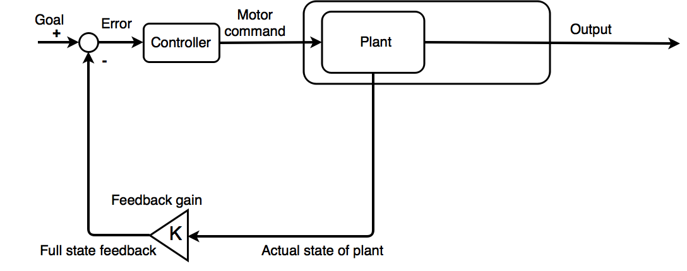
Direct state feedback control
Full state feedback can be used to effectively control the plant
This lets us specify behavior by using suitable feedback gain K

Slide 16
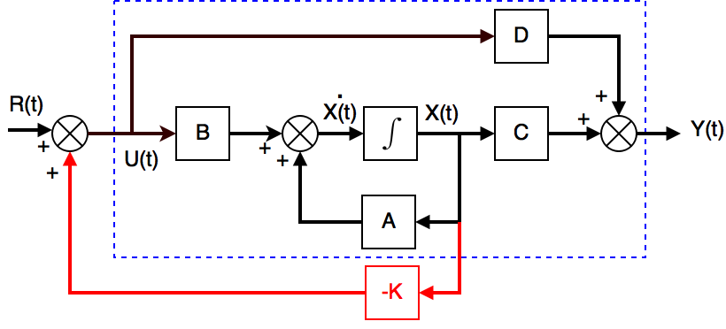
Using open loop observer to estimate state
Many procedures for control design assume the full state vector is available
This is not always the case!
Measurements may require costly measurement devices
It may also be impossible to measure all state variables
However it may be possible to construct an approximation to the full state vector using available measurements
The method of estimation essentially provides you with a virtual sensor!
An observer can estimate the states of the system from the output measurements.

Slide 17
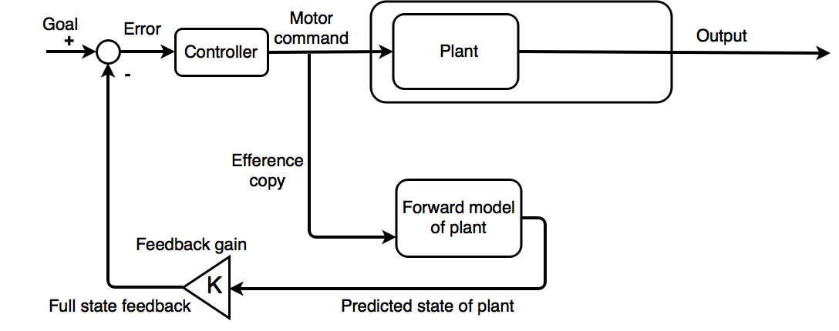
State feedback control using an observer
Full state often not available
So use an observer to estimate the full state
The estimator here is open loop it can easily diverge from the true states
This can happen due to disturbances or an imprecise model of the plant

Slide 18
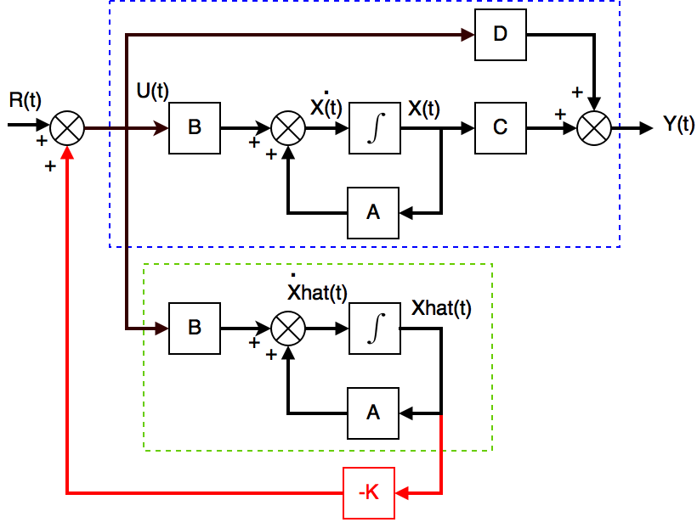
Using open loop observer to estimate state
We can make an open loop estimate the state simulation using a model of the real state space system
We call estimated state Xhat
State space system
Open loop model
of system
This is like a copy of the real system

Slide 19
Using open loop observer to estimate state
Analyzing the system
where Xhat is an open loop estimated state
The state estimation error is given by the different between this estimate and the actual state
Differentiating both sides of this equation w.r.t. time
From the actual state space model we know that
Substituting in the state space equations

Slide 20
Using open loop observer to estimate state
So from
But from before the state error is given by
Therefore the state error at time t is given by the solution to this equation

Slide 21
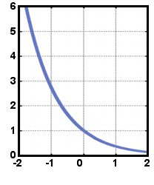
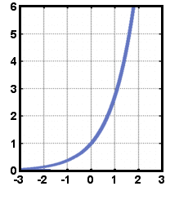
Using open loop observer to estimate state
So from the equation of error dynamics
It can been seen that the error dynamics depend on eigenvalues of A
Want exponential decay of error
Don’t want exponential growth
Clearly we want error to go to zero at some (ideally short) value of time t
If A unstable then this will not happen and the estimated state will diverge from the true state
We note that for a given system, we cannot arbitrarily change the location of the eigenvalues of A, because we cannot change A!
We need a formulation that lets us select the eigenvalue locations

Slide 22
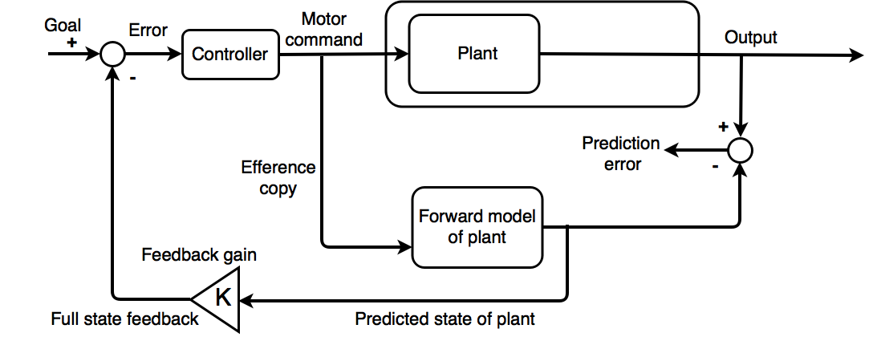
Consider observer prediction error
Note we can calculate prediction error as difference between predicted and actual output
Want to use a feedback circuit so we can get error to decay faster than it would open loop
Also want to make sure we use real output of system in case model is inaccurate

Slide 23
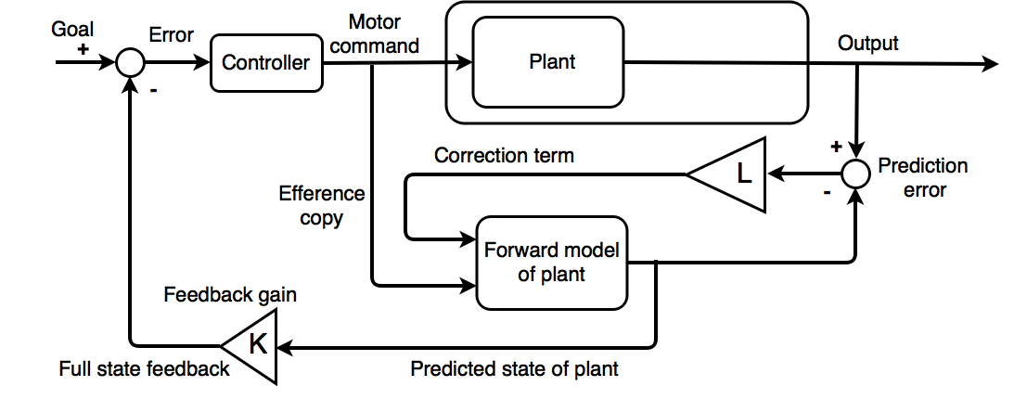
Observer with correction term
Observer can uses prediction error to correct its state estimate
Correction term is in another control loop that tries to drive the prediction error to zero
Use feedback controller with gain L to help reduce prediction error

Slide 24
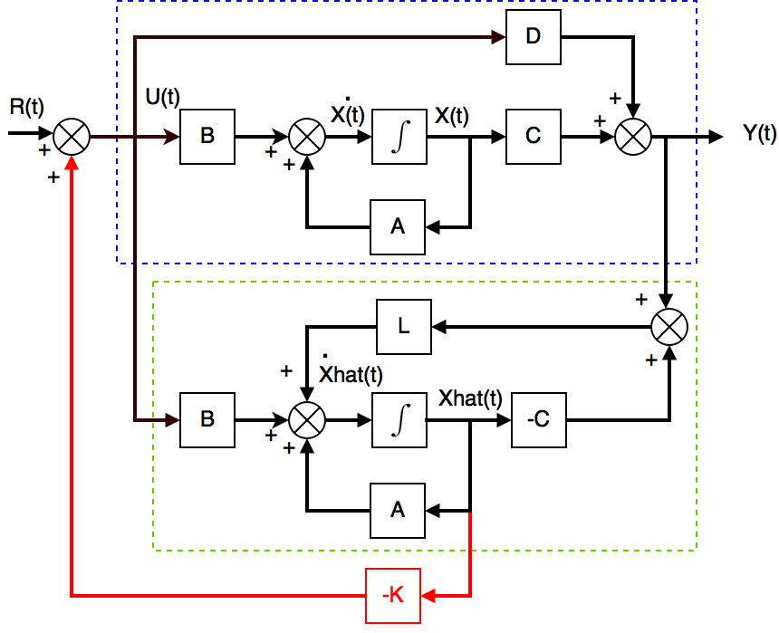
Using closed loop observer to estimate state
The modified observer structure appears as follows
State estimate
Open loop term
Output error correction term
State space
system
Open loop model
of system
Output error correction term

Slide 25
Using closed loop observer to estimate state
Given the state estimate with output error correction
The state estimation error is given by
Substituting in the state space equations now gives
So error dynamics now depend on eigenvalues of (A-LC) and not just on A
Need to choose L so that (A-LC) has –ve eigenvalues so error decays away
This is very similar to choosing gain to get controllable SFC system

Slide 26
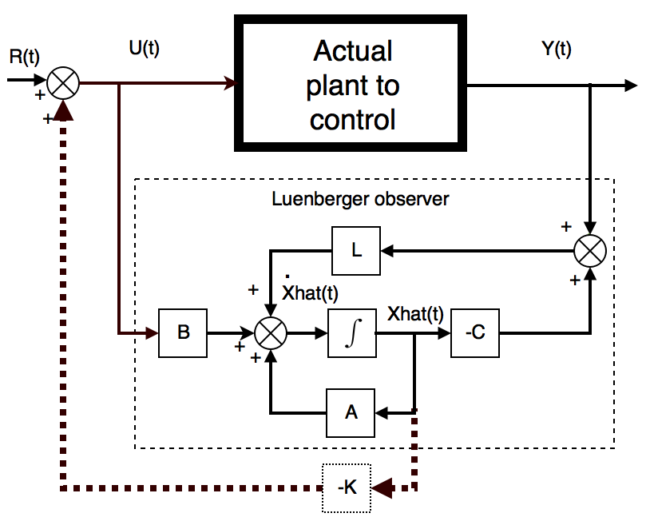
Control of real system using SFC with observer
To summarize:
We do not generally have access to the actual state of the system we want to control
Therefore we need to estimate its internal states using an observer
But we can use the real output to improve our state estimate
The input control signal is denoted as U(t).
The actual system output is denoted as Y(t) which is feedback to the observer to improve its state estimate Xhat(t).
The blocks A, B, C, and D represent multiplication by the state space matrices that form the model of the actual plant.

Slide 27
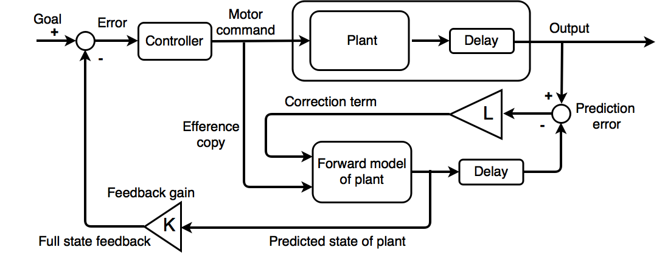
Dealing with correction term delay
An observer can also deal with delays
Prediction error can be calculated after same delay as plant delay
And then used to correct the state estimate

Slide 28
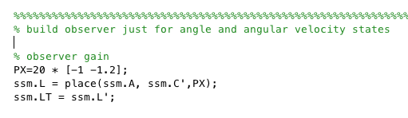
Ackermann observer gain calculation
To choose Luenberger estimation gain L
Can choose appropriate observer gains L by pole placement or using an optimality criteria
Can find gain by algebraic manipulation by hand just like when finding SFC feedback gains
However easier to perform pole placement can be achieved using the Ackermann formula or the place command in Matlab

Slide 29
ROCO218: Control Engineering Dr Ian Howard Lecture 7 Gaussian elimination to achieve echelon form

Slide 30
Gaussian elimination
Gaussian Elimination is a method often used to solve simultaneous linear equations of the form AX=b
Can use forward elimination is to transform a coefficient matrix into an upper triangular matrix
After forward elimination done, back substitution can be employed to to solve equations ( we wont need that here)
It can also inform us of the rank of a matrix A
We will need t determine the rank of a matrix is our subsequent analyses of controllability and operability of state space models

Slide 31
Gaussian elimination
Forward elimination
Starting with the first row, add or subtract multiples of that row to eliminate the first coefficient from the second row and beyond.
Continue this process with the second row to remove the second coefficient from the third row and beyond.
Stop when an upper triangular matrix remains

Slide 32
Matrix rank
Rank = 3
If a matrix can be reduced to upper triangular form and rows are nonzero then matrix is full rank
Rank given by number of non-zero rows of triangular matrix
Rank = 2
Rank = 1

Slide 33
Matrix rank examples
Example1: consider the 2x2 matrix
Both rows contain non-zero elements
Therefore rank = 2, which is full rank for 2x2 matrix

Slide 34
Matrix rank examples
Example2: consider s 2x2 matrix
Only top rows contains non-zero elements
Therefore rank = 1, which is less than full rank for 2x2 matrix
Note that here the 1st and 2nd row vectors are linearly dependent

Slide 35
ROCO218: Control Engineering Dr Ian Howard Lecture 7 Controllability

Slide 36
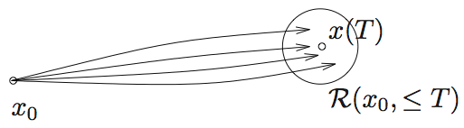
Controllability
Given the state space system
The LTI system is controllable if, for every x*(t) and every finite T > 0, there exists an input function u(t), 0 < t ≤ T, such that the system state goes from x(0) = 0 to x(T) = x*
Here we disregard the output measurements of the system and only focus on the evolution of the state

Slide 37
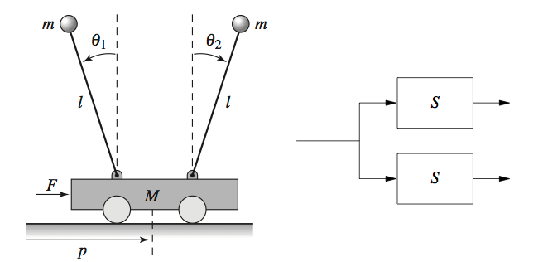
Controllability
Intuitive example of a non-controllable system
Above system consists of two identical sub-systems with the same input.
Same force acts on two pendula
Not possible to arbitrarily control both pendulums at the same time.
Cannot reach arbitrary state so the system is not controllable/reachable.

Slide 38
Controllability
If system matrix A has a diagonal form the system is controllability if column vector B has no non-zero elements
For example
A diagonal matrix A means at the states are uncoupled
Therefore
In this case the control input can drive and influence all state variables
Therefore the system is controllable

Slide 39
Controllability
Another example
Therefore
In this case the control input cannot drive and influence all state variables
Therefore the system is not controllable

Slide 40
Controllability matrix key result
In the general case the matrix A will not be diagonal o states can be coupled together
In this case we cannot just use inspection and need to examine the controllability matrix to say if the system is controllable
The controllability matrix is given by the expression
The system is only fully controllable if the controllability matrix is full rank

Slide 41
Controllability example
Given the state space system
Since this has a 2x2 system matrix, the system controllability is given by
Calculating the AB term gives

Slide 42
Controllability example
Substituting in A and AB we have
Using Gaussian elimination to try to achieve echelon form
It can be seen that the reduced echelon form matrix has full rank of 2
Therefore the system is controllable

Slide 43
ROCO218: Control Engineering Dr Ian Howard Lecture 7 Observability

Slide 44
Observability matrix key result
Given the state space system
The LTI system is observable if the initial state x(0) can be uniquely deduced from the knowledge of the input u(t) and output y(t) for all t between 0 and any finite T > 0
In many application, it is not practical to measure all of the states directly
A system is observable if there is no hidden dynamics inside it

Slide 45
Observability matrix key result
If system matrix A has a diagonal form system controllability if output row vector C has no non-zero elements
For example
A diagonal matrix A means at the states are uncoupled
In this case we have
In this case all state variables are coupled to the output and have an effect on the output Y
Therefore the system is observable

Slide 46
Observability matrix key result
If system matrix A has a diagonal form system controllability if output row vector C has no non-zero elements
For example
A diagonal matrix A means at the states are uncoupled
In this case we have
In this case not all state variables are coupled to the output and have an effect on the output Y
X₃ does not influence the output Y
Therefore the system is not observable

Slide 47
Observability matrix key result
In the general case A will not be diagonal
In this case we need to examine the observability matrix.
The system observability matrix is given by
The system is only fully observable if the observability matrix is full rank

Slide 48
Observability example
Given the state space system
Since this has a 2x2 system matrix, the system observability is given by
Calculating the CA term gives

Slide 49
Observability example
Substituting in C and CA we have
Using Gaussian elimination to try to achieve echelon form
It can be seen that the reduced echelon form matrix has rank of 1 which is less than full rank of 2
This can be seen by inspection since the two rows in M_{o} were linearly dependent, differing only in scaling factor of -2
Therefore the system is not observable

Slide 50
Stability, controllability and observability
The eigenvalues of matrix A must satisfy the equation
And this has a non-zero solution if the determinant of the matrix (A-I)=0
System has a 2x2 system matrix, so controllability matrix is given by
System has a 2x2 system matrix, so observability matrix is given by

Slide 51
ROCO218: Control Engineering Lecture 7 2015 exam for ROCO316 Modern Control Solutions to relevant questions

Slide 52
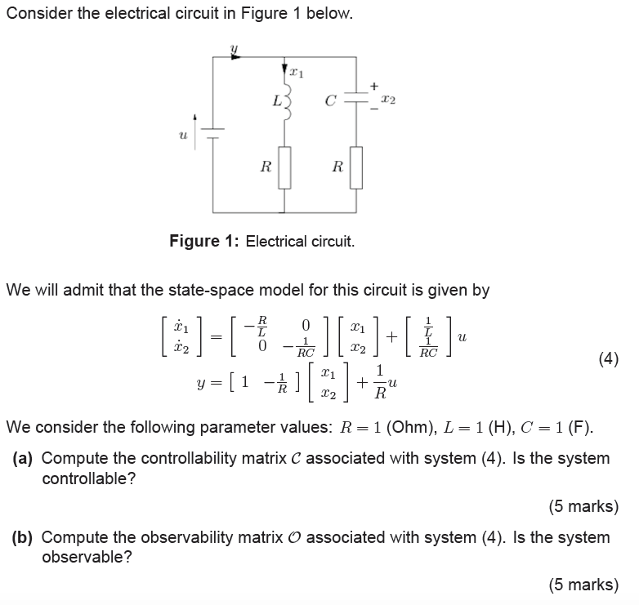
Q2: Electrical circuit

Slide 53
Q2: Electrical circuit
Substituting in the value of L and R into
Therefore the system matrices are given by

Slide 54
Q2: Electrical circuit
Since our system has a 2x2 system matrix, the system controllability is given by
Calculating the AB term gives
Using Gaussian elimination to try to achieve echelon form
It can be seen (also by inspection) that the reduced echelon form matrix only has rank of 1, therefore the system is not controllable

Slide 55
Q2: Electrical circuit
Since our system has a 2x2 system matrix, the system observability matrix is given by
Calculating the CA term gives
Using Gaussian elimination to try to achieve echelon form
It can be seen (also by inspection) that the reduced echelon form matrix only has rank of 1, so system is not observable

Slide 56
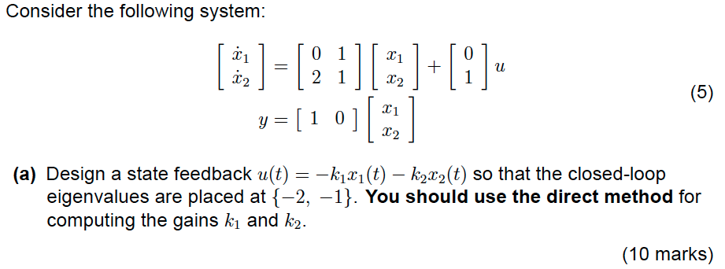
Q3: State space control

Slide 57
Q3: State space control
From state space system
Applying state feedback control
where
To the state space equation
Leads to the the modified relationship
Stability determined by location of poles which are the eigenvalue of matrix (A-BK)

Slide 58
Q3: State space control
We require that the eigenvalues λ of the controller system are at -2,-1
This means we will want the following characteristic equation for the eigenvalues
The eigenvalues λ of the closed loop system are given by
Substituting in values for B we have

Slide 59
Q3: State space control
Expanding
We now need to match the coefficients in the desired eigenvalues characteristic equation using the appropriate gain vector K

